Slide 1
Space-based Solar Power
By: Steven Buck
Mentor: Dr. Ahmed Sulyman

Slide 2
Overview
Background
Assumptions
Requirements
Design
Results
Conclusion

Slide 3
Background
Satellite in orbit collects solar energy
Transmit stored power using microwaves
NASA created plan in 1999
China currently working on a design
JAXA currently working on a design
  JAXA successfully transmitted several kW from 50-500m
Other groups mainly looked at PCB rectenna designs

Slide 4
Assumptions
Almost no effect from phase difference
Small loss in combiner board
No cable/equipment loss
Ignoring ground effect

Slide 5
Requirements
Final design should be able to charge a phone at 100m
Design will use parabolic antennas

Slide 6
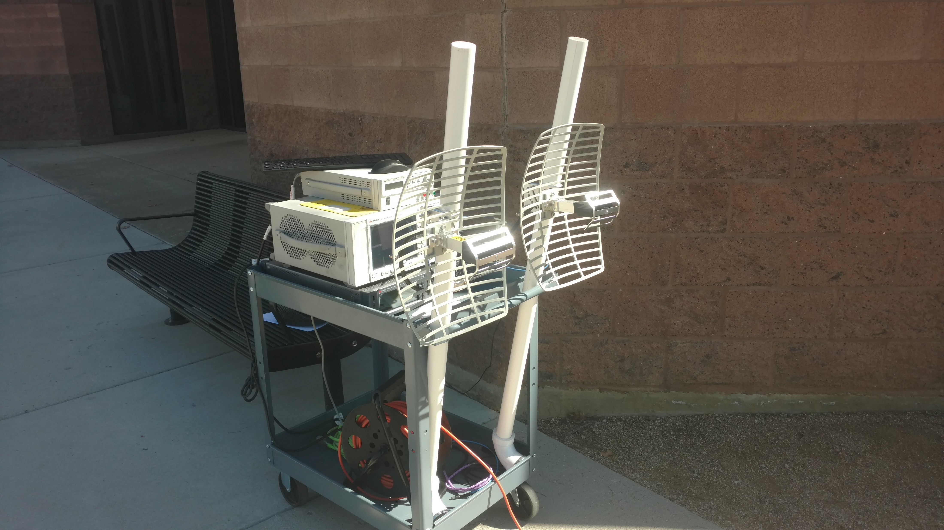
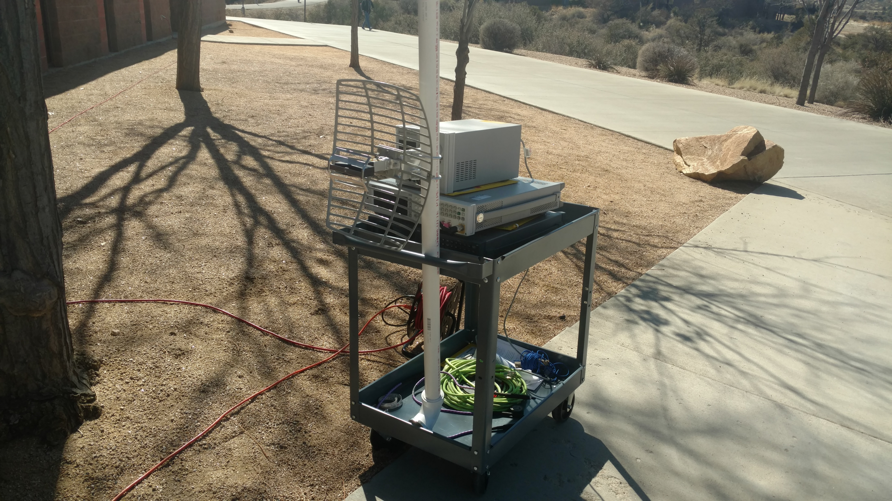
Design
Frequency: 2.42 GHz
Transmit power: 10-30 dBm
Transmit gain: 15 dBi
Receiver gain: 15-75 dBi

Slide 7
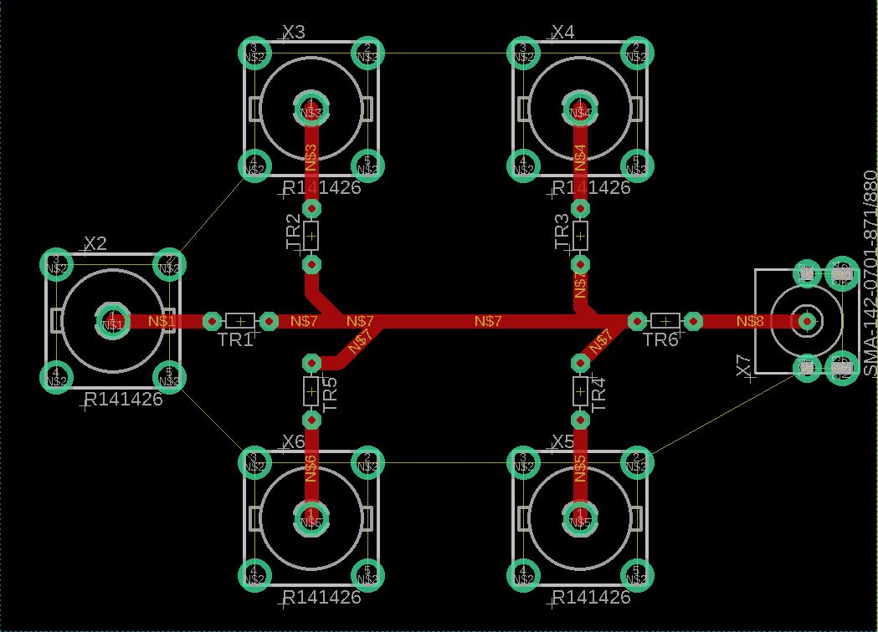
Combiner Design
First iteration simply attached each antenna
  Each antenna decreased receiver power by over 5 dBm
Second iteration used a passive combiner circuit
  Each antenna did not cause a significant change in received power

Slide 8
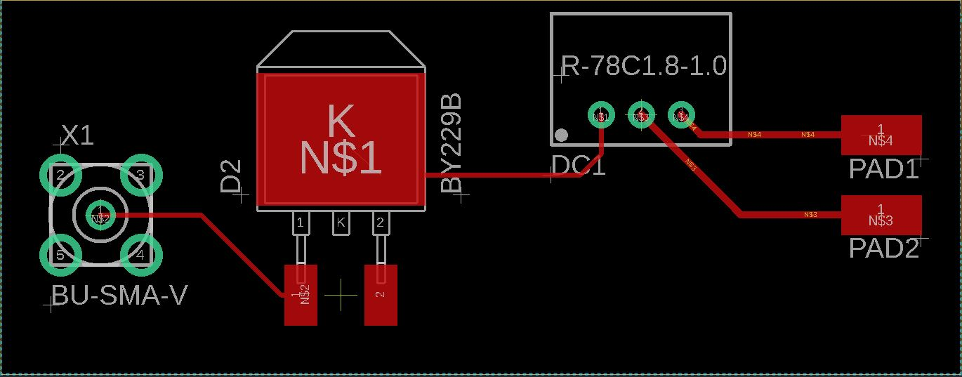
Converter Design
Has not been fully tested
Low pass filter to remove unwanted noise
Diode removes one half of the RF signal
DC/DC converter changes half signal to DC at 5V

Slide 9
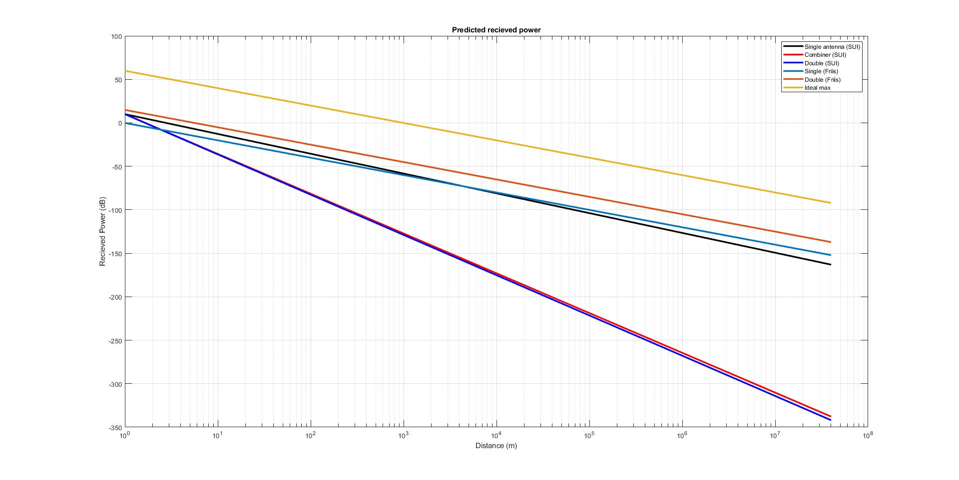
Results

Slide 10
Results
Phase difference caused 5dBm of loss with simple combiner
Passive combiner board added 20dBm of loss
At 10m a transmit power of around 60dBm (1kW)
Improvements are needed for further testing

Slide 11
Conclusion
17MW for geosynchronous satellite
2-17kW for LEO satellite
  Commercial magnetrons are easily available for 2kW
  Should be able to fit in 12-16U cubesat for LEO tests
Future tests needed
  Combiner board re-design to reduce loss and phase match received signals
  Additional tests to attempt data transmission with power transmission
  Modify mounting to prevent ground effect

Slide 12
Questions?
Steven Buck
stvnbck8@gmail.com

